Slide 1
Installing Package bees

Slide 2
Things you will need
Pliers (regular and needle-nose)
Hive tool
Bee brush
Smoker and fuel (probably not needed, but best to be prepared)
Misting bottle filled with sugar syrup (1:1 ratio, sugar-water w/HBH )
Bee suit and veil
Duct tape
Gloves
Extra box(es)
Feeder(s): pails or hive top (if hive top, bring a pail of sugar syrup to fill it; if feeder pails make sure they are full)
Wire, or rubber bands (<10”) (to suspend/hold the queen cage in the new colony)
Brick or stone (to weigh down the new colony’s cover)
Entrance reducer (must downsize the entrance to 1”)
A means to secure the entrance reducer (push pins, a small nail, even duct tape)
Hand operated staple gun
Hammer and a few nails
Notebook
Camera (This is a once in a lifetime event)
Bees – you will have to order them around December or January

Slide 3
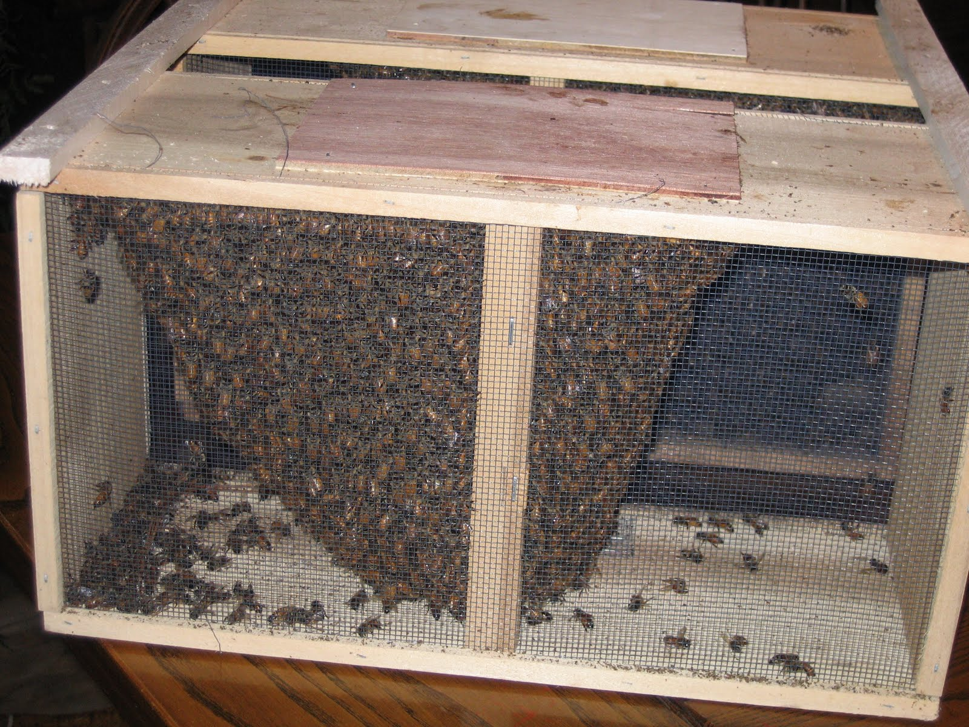
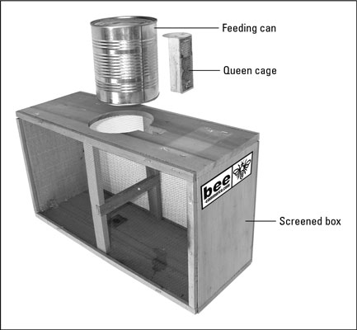
Bees are sold by the pound ~ 3,500 bees in a pound. The most common size has 3 pounds or more than 10,000 bees. There will be some dead bees on the bottom of the cage; if there is more than ½ “ thick layer contact your supplier.

Slide 4
Things you should know…
It is recommended to start out in beekeeping with two colonies.
It’s best to order your bees from a local supplier.
Install your bees a.s.a.p. if conditions are right. If temperatures are below 40 F - wait.
Get the bees home a.s.a.p. If your not able to install the bees immediately feed the bees 1:1 sugar water by spraying them in the cage from both sides. Do not saturate them. Do this at least twice a day as long as they are in storage . Don’t assume that they are getting food from the can in the cage. Keep them in a cool dark place on a newspaper.
Set up your hive the day before you are going to install. The fewer things you have to do the day of installation the better.
The best time to install your bees is 1 hour to 45 minutes before dark.
**INSTALLING YOUR BEES**

Slide 5
What’s Next…
BE PATIENT!
Return 5 – 7 days later
Make sure the queen has been released
Remove the queen cage
Return a week later to see that she is laying
Continue to feed your bees until you have to add a honey super
When 6 frames are being worked (8 frame equipment) switch the two outer frames in one frame and add the second box. The same goes for 10 frame equipment when 8 frames are being worked switch the two outer frames in one frame and add the second box.
Remember your new colony will not actually start to grow for 4 weeks, in fact the population will decline during those first four weeks.
ENJOY YOUR BEES!!!

